Slide 1
Atmospheric Feedbacks
POSITIVE
NEGATIVE
Increased CO₂
More water vapor & other changes
+
Higher temperature
+
Increased cloud cover
More water vapor
More reflected solar radiation
–
More absorbed infrared radiation
Lower temperature
+
+
Higher temperature
Less water vapor
+
More water vapor

Slide 2
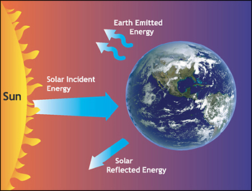
radiations

Slide 3
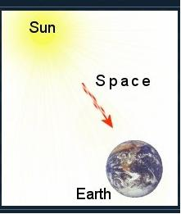
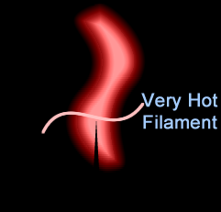
Radiation
All matter having temperature higher than absolute zero emits energy in the form of thermal radiation
Rate of emission depends on the surface, nature and temperature of body
At the same time it receive (absorb) radiations from surrounding.
According to Maxwell, transfer of heat or thermal energy through radiation is propagated from one to another position without intervening the medium or space just like light energy propagates
As an electromagnetic wave, thermal radiation follow:
In free space have speed of light
Follow straight line path
reflection, refraction, interference, diffraction, polarization

Slide 4
Radiation and physical objects
Any physical material (solid, liquid, gas) interacts with
electromagnetic waves (radiation) in one of four different ways.
TRANSMISSION: waves pass through the material
ABSORPTION: some of the waves are absorbed (& heat)
REFLECTION: some of the waves are reflected in the direction
they came from.
EMISSION: Every object (above absolute zero) emits radiation
because it possesses thermal energy
Less important:-
SCATTERING: waves are deflected (hence blue sky…)

Slide 5
A key fact for Earth’s climate is that gases in the atmosphere absorb radiation.
Molecules absorb radiation at particular wavelengths, depending on amount of energy required to cause vibration or rotation of atomic bond.
Two essential things for the greenhouse effect:
The Earth’s atmosphere is mostly transparent to visible radiation (why not totally)
The Earth’s atmosphere is mostly opaque to infrared radiation.
Notes:
You are all familiar with this because you know that in a microwave oven, only water molecules vibrate in response to microwaves. Most of the molecules in the food you are trying to heat are two large to respond to this particular wavelength of light.
Size of molecules….
or excitation of electrons.
O₃ absorbs radiation near 10 μm
CO₂ absorbs radiation near 15 μm

Slide 6
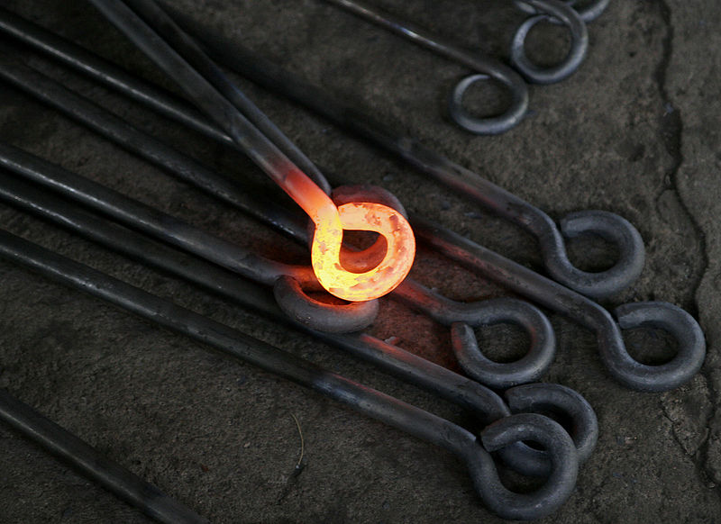
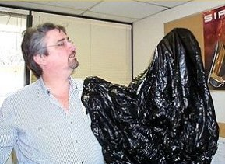
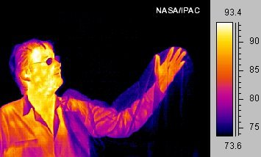
Much of a person's energy is radiated away in the form of infrared light. Some materials are transparent in the infrared, while opaque to visible light, as is the plastic bag in this infrared image. Other materials are transparent to visible light, while opaque or reflective in the infrared, noticeable by darkness of the man's glasses

Slide 7
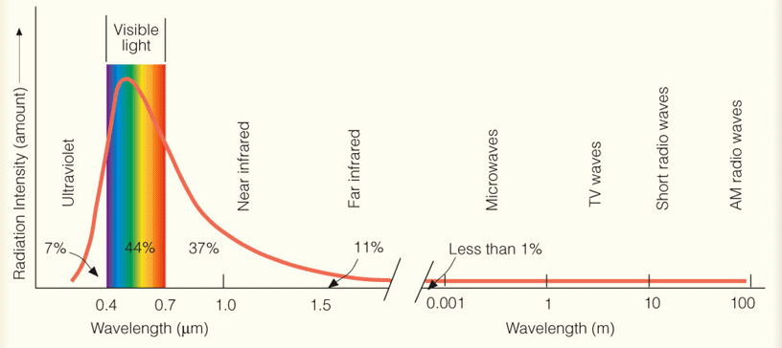
Radiation

Slide 8
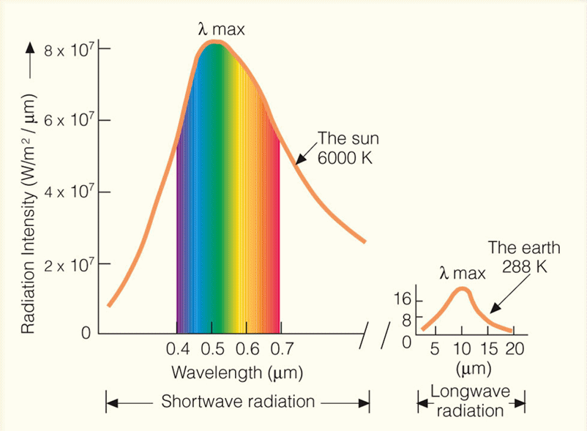
Blackbody radiation curves typical for the Sun and Earth

Slide 9
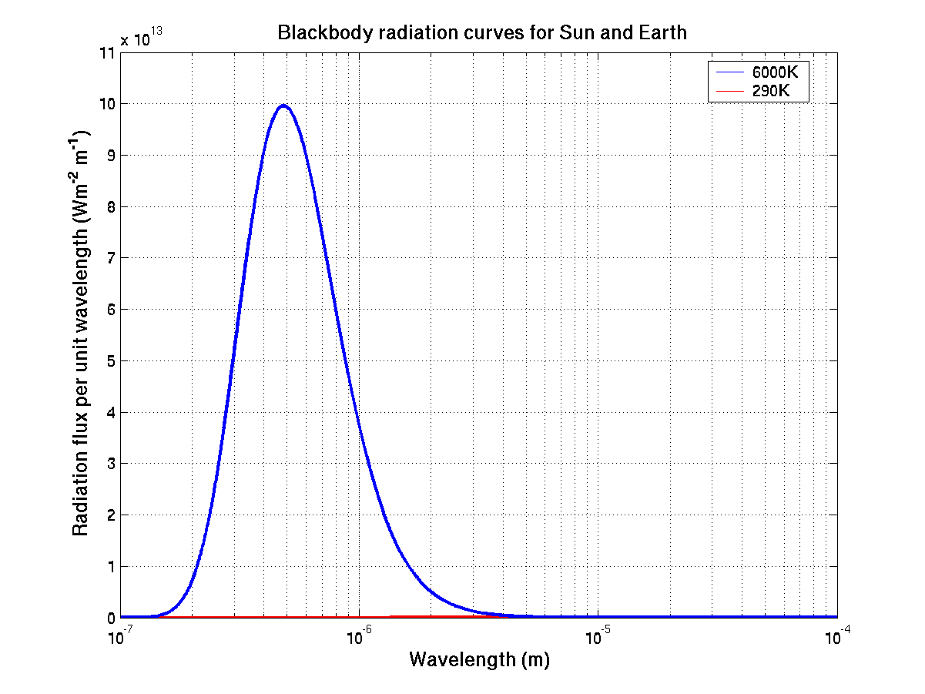
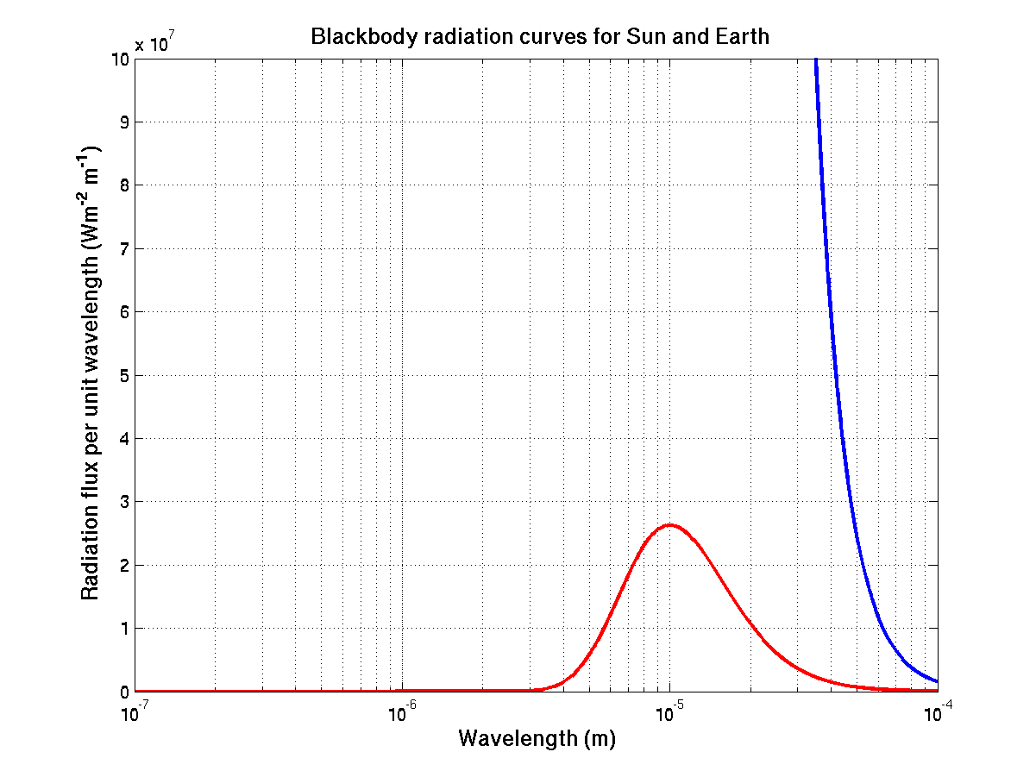
Blackbody radiation curves typical for the Sun and Earth
Sun ~6000K
Earth ~290K
Sun radiates a lot more energy that the Earth!

Slide 10
Radiation
Useful definitions:
total energy density (u): total radiant energy per unit volume for all wavelength radiating at any point
spectral energy density (u_{λ}): energy per unit volume for a range of λ
total emissive power (E): radiant energy per unit time per unit surface area of body for all wavelength
spectral emissive power (e_{λ}): radiant energy per unit time per unit surface area at particular wavelength
absorptive power (a_{λ}): ratio of absorbed energy to total energy at particular termp and wavelength
relative emittance (e): ratio of emittance by a surface to emittance of black body. e = E’/E

Slide 11
Black Body Radiation
A body that absorbs all radiation incident upon it, regardless of frequency, is called a blackbody.
Ability of a body to radiate is closely related to its ability to absorb radiation.
As it is a perfect absorber, it is also perfect radiator.
As blackbody absorbs all the radiations and doesn’t reflector transmitted any, it appears black

Slide 12
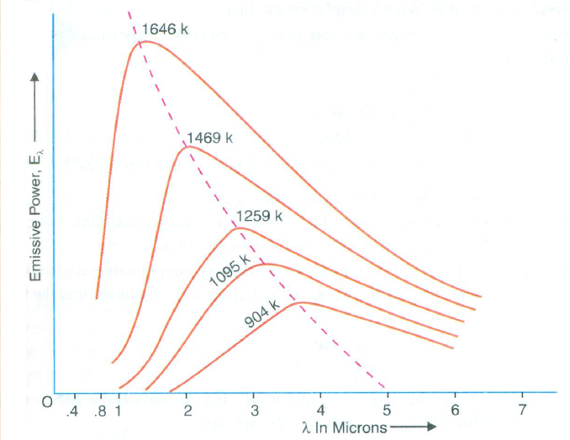
Black Body Radiation Curves
At a given temperature (T), the energy is not uniformly distributed in the radiation spectrum of a black body.
At a given T, the intensity of heat radiation increases with ↑ in λ and at a particular λ its value is maximum i.e. λ_{m}. With further ↑ in λ, the intensity of heat radiation ↓.
An ↑ in T causes a ↓ in λ_{m}, such that λ_{m}T=constt. This is called Wein’s displacement law.
An ↑ in T causes an ↑ in the energy emission, for all wavelentgh.
(v) The area under each curve represents the total energy emitted by the body at a particular temperature for the range of λs considered. This area ↑s with ↑ in temperature of the body. It is found that the area is directly proportional to the fourth power of the temperature of the body, i.e. , E∝ T⁴ , this represents Stefan-Boltzmann’s law.

Slide 13
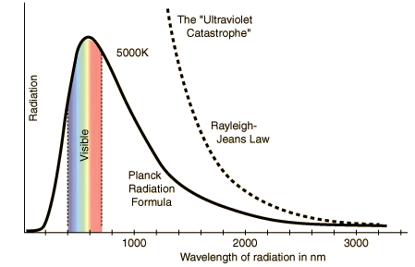
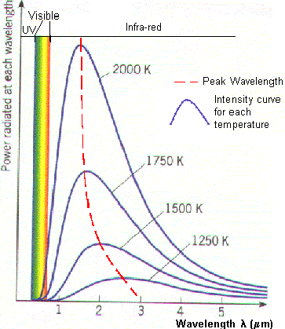
The black body radiation curve shows that
The black body does radiate energy at every wavelength. Energy of the radiation initially increases, reaching at a maxima (peak wavelength) then decreases but never goes to zero.
At 5000K the peak wavelength is about (500nm or 0.5 μm) which is in the visible light region. (Example : Sun)
At each temperature the black body emits a standard amount of energy. This is represented by the area under the curve. (Stefan’s Law) E∝ T⁴
As the temperature increases, the peak wavelength emitted by the black body decreases. (Wien’s displacement law)
It therefore begins to move from the infra-red towards the visible part of the spectrum.
Fig 1: Black body radiation curve for 5000K. Peak wavelength is 500nm.
Fig 2: Black body radiation curves showing peak wavelengths (Red line) at various temperatures

Slide 14
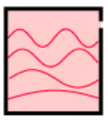
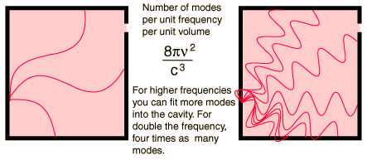
Rayleigh-Jeans Law: First Attempt to explain Radiation
curve behavior.
Rayleigh and Jeans considered the radiation inside the black body (cavity) to be a series of standing electromagnetic waves, on the assumption that the em wave radiation spectrum emitted by a black body continuously vary in wavelengths from zero to infinity
The number of standing waves per unit volume (density of em standing waves or allowed modes or density of states) is
This equation is independent of shape of the cavity. λ is wavelength, v is frequency and c is speed of light.

Slide 15
Planck’s Quantum Postulates
A black body radiation chamber is filled up not only with radiation, but also with simple harmonic oscillators or resonators (energy emitters) of the molecular dimensions, known as Planck's oscillators or Planck's resonators, which can vibrate, with all possible frequencies. The vibration of the resonator entails one degree of freedom only.
The oscillators (or resonators) cannot radiate or absorb energy continuously, but energy is emitted or absorbed in the form of packets or quanta called photons. the theory states that the exchange of energy between radiation and matter cannot take place continuously but only in certain multiples of the fundamental frequency of the resonator (energy emitter).
As the energy of a photon is hv, the energy emitted (or absorbed) is equal to 0, hv, 2hv, 3hv, ..........nhv, i.e., in multiplets of some small unit, called as quantum.
Notes:
A black body radiation chamber is filled up not only with radiation, but also with simple harmonic oscillators or resonators (energy emitters) of the molecular dimensions, known as Planck's oscillators or Planck's resonators, which can vibrate, with all possible frequencies. The vibration of the resonator entails one degree of freedom only.
The oscillators (or resonators) cannot radiate or absorb energy continuously, but energy is emitted or absorbed in the form of packets or quanta called photons. Planck assumed that each photon has an energy hv where h is the Planck's constant, its value being equal to 6.625 × 10⁻³⁴ Joule-sec, and v is the frequency of radiation. This assumption is the most revolutionary in character. In other words, the theory states that the exchange of energy between radiation and matter cannot take place continuously but only in certain multiples of the fundamental frequency of the resonator (energy emitter).As the energy of a photon is hv, the energy emitted (or absorbed) is equal to 0, hv, 2hv, 3hv, ..........nhv, i.e., in multiplets of some small unit, called as quantum.

Slide 16
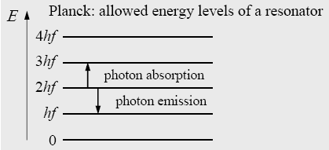
Max Planck:
blackbody radiation is produced by vibrating submicroscopic electric charges, which he called resonators the walls of a cavity are composed of resonators vibrating at different frequency.
Classical Maxwell theory:
An oscillator of frequency ν could have any value of energy and could change its amplitude continuously by radiating any fraction of its energy
Planck: the total energy of a resonator with frequency ν could only be an integer multiple of hν. (During emission or absorption of light) resonator can change its energy only by the quantum of energy ΔE=hν
E=nhν where n 1,2,3,...
ΔE=hν
4hν
3hν
2hν
hν
0

Slide 17
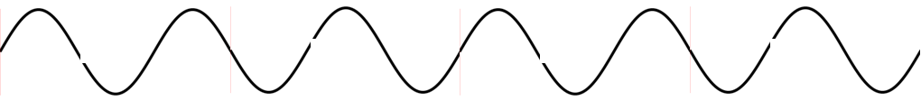

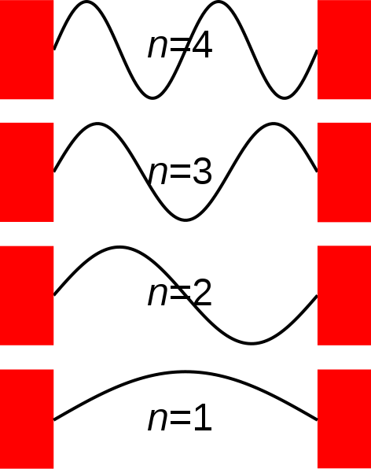
E_{n}=nhν
N_{n}
Total Energy (E) = N_{o}E_{o}+N₁E₁+N₂E₂+N₃E₃…+N_{n}E_{n}
Total number of resonators (N)=N_{o}+N₁+N₂+N₃…+N_{n}
E₃=3hν
N₃
E₂=2hν
N₂
N₁
E₁=hν
E_{o}=0
N_{o}
Therefore average energy(ε)=Σ E_{n}/Σ N_{n}

Slide 18
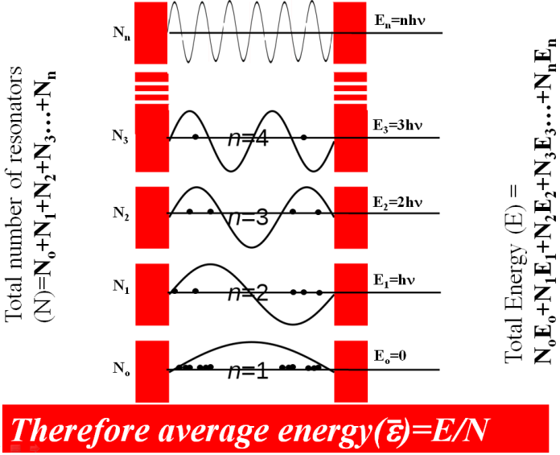
Average energy of Planck's oscillator:
According to Maxwell's law of molecular motion,
If N_{o} → number of resonators having energy zero, then the number of resonators N₁ having energy E₁ will be
N_{o} e^{-hν/kT} , similarly for N₂ = N_{o}e^{-2hν/kT} and N_{n} = N_{o} e^{-nhν/kT} .
The total energy of Plank’s resonator will be
∴ av. Energy of a resonator will be

Slide 19
Therefore, the energy density belonging to the range dv can be obtained by multiplying the average energy of Planck's oscillator by the number of oscillators per unit volume, in this frequency range ν and (ν + dv).
where u(ν)dν is energy density (i.e., total energy per unit volume) belonging to the range dv called Planck's radiation law in terms of frequency.

Slide 20
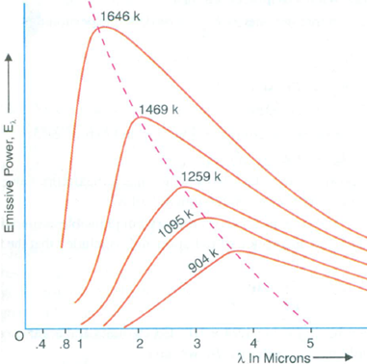
Wien’s displacement law
The wavelength whose energy density is greatest can be obtained by setting
and solving for λ = λ_{max}. We find
Which may be written as
This equation is known as Wien’s displacement law. It quantitatively expresses the empirical fact that the peak in the black body spectrum shifts progressively to shorter wavelength (higher frequencies) as the temperature is increased.

Slide 21
Wien’s Displacement Law
Hot objects (stars) emit radiation that peaks at relatively short wavelength
The blackbody temperature is 6000K
For the Sun it is about 0.5μm
Cold objects (planets, like the Earth-atmosphere system) emit peak radiation at longer wavelengths
The blackbody temperature is 288K (15ºC)
For the Earth it is about 10μm

Slide 22
Stefan-Boltzmann Law
Total energy density within the cavity can be obtained by integrating energy density (eq. 3) over all frequencies. Thus
Here a is a universal constant. According to the equation, the total energy density is proportional to the fourth power of the absolute temperature of the cavity walls. Therefore we expect that energy E radiated by a black body per second per unit area is also proportional to T⁴ i.e.
Where, e = emissivity, ranges from 0 (for perfectly reflecting surface) to 1 (for a black body, and σ (Stefan’s constant) = ac/4 =5.67x10⁻⁸ watt/m²-K⁴.
This equation is known as Stefan-Boltzmann Law.

Slide 23
Q1: An x-ray photon is scattered by an electron. The frequency of the scattered photon relative to that of the incident photon (a) increases, (b) decreases, or (c) remains the same.
Quest:
Ans: (b)
Q2. A photon of energy E₀ strikes a free electron. The scattered photon with energy E moves in opposite direction that of the incident photon. In this Compton effect interaction, the resulting kinetic energy of the electron is (a) E₀ , (b) E , (c) E₀ − E , (d) E₀ + E , (e) none of the above.
Ans: (c)
Q3. Deduce the expression for the maximum kinetic energy of the recoiled electron.
Q4. Why Compton effect not observed with visible light.
Q5. Explain the presence of unmodified scattered radiation along with modified radiations for non zero scattering angle.

